Slide 1
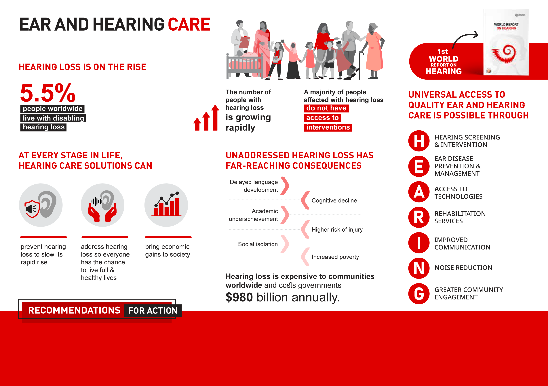
ADD COUNTRY NAME
^{This includes}
^{xx million}
^{with unaddressed}
^{hearing loss in}
^{Country name}
Add country recommendation
Add country recommendation
Add country recommendation
Add country recommendation
Add country recommendation

