Slide 1
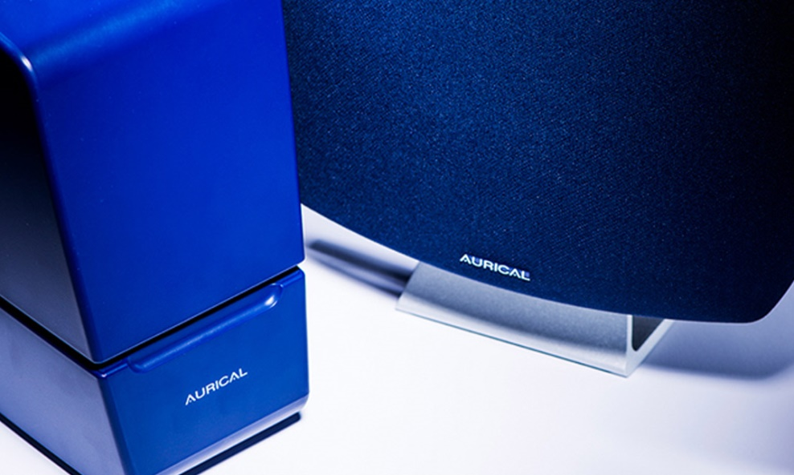
Adult RECDs Practical Guide following publication of BAA/BSA Joint Guidance: January 2021
Notes:
This presentation delivers an informative guide and step by step process on how Real Ear to Coupler (RECD) measurements are performed and applied to adult hearing aid fitting services.
This training guide has been updated following recent publication of BSA/BAA Joint Guidance on ‘’The Setting and Verifying The Frequency Response of a Hearing Aid Remotely for Adults During Periods of Restricted Service Delivery in February 2021 and it overrides the original RECD training resource.
Other Guidance Used:
A Guide to Remote Working in Audiology Services During COVID-19 and Beyond (BAA SQC/ManCAD (2020)
The AURICLE HIT and Otosuite Reference Manual (2015)
BSA (2018) Recommended procedure for Real Ear Measurements
Other evidence based resources and literature.
Natus Gudiance
1

Slide 2
What is an RECD?
RECD is the difference in dB across frequencies between the sound pressure level (SPL) in the “real-ear” and SPL measured in a 2cc coupler, produced by a transducer generating the same input signal in both.
Real Ear SPL – 2CC coupler SPL = RECD

Slide 3
RECDs: Adult Service
During periods of restricted face to face activity, coupler fittings with measured RECDs are the gold standard for verification of remote fittings with occluded earpieces (BSA/BAA, 2021).
Functionally, RECD’s are not intended to replace REMs, hence the long term practicality and feasibility of utilising RECD’s routinely in clinical practice post COVID-19 remains uncertain.
The BAA Service Quality Committee and BSA Adult Rehabilitation Interest Group have operationalised new guidance on how to perform RECD measures specifically for adult population.
This practical guide has been developed to reflect the BSA/BAA Adult RECD Guidance.

Slide 4
Setting Up For RECD
You will need a RECD probe tube attached to the REM headset.
This must be a probe that has two outlets:
The REM tube attachment
RECD transducer tubing attachment with coupling attachment.
2)
1)

Slide 5
Display RECD in PMM
Open Otosuite and click ‘Navigator’, then ‘RECD’ in PMM.
Next, click on ‘Control Panel’ to connect the Free Fit.
If the RECD tab is not displayed you will need to add it.
To do this click on:
Tools >Configuration Wizard > PMM Configure > Click ‘Next’ until you get to the ‘Test Type’ screen.
Ensure that the ‘Show RECD Test Type’ is selected’ then click finish.

Slide 6
Display RECD in PMM
Click on Tools > Configuration Wizard > ‘Next’ until you get to the ‘Protect User Tests’ Screen, Click ‘ Allow editing during this session’ > Finish

Slide 7
Reference Microphone Calibration
Ensure Reference Microphone Calibration is completed at the start the session.
Select Tools> AURICAL HIT Calibration > Reference Microphone.
Follow the on-screen instructions.
Position the reference microphone (1) pointing straight down from above and centred 1-2 millimetres above the coupler measurement microphone (2)
Close the lid and complete calibration.
1)
2)

Slide 8
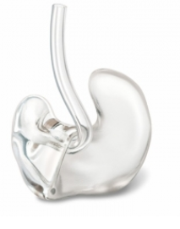
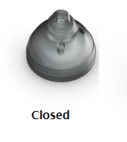
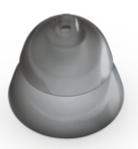
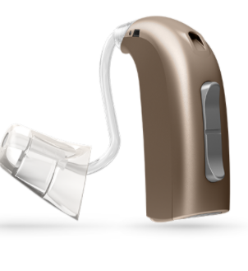
Please Note
Measured RECDs should only be performed for:
Earmoulds with <3mm vents including fully occluded moulds.
Thin Tube Fittings including:
(double, single, power domes or micro-mould).
Notes:
8

Slide 9
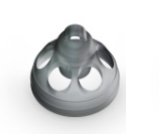
Please Note
RECDs should NOT be performed for:
Earmoulds with ≥ 3mm vent including open claw, ring and gap moulds.
2) Open Dome Thin-Tube Fittings
Notes:
9

Slide 10
Effect of Venting
Measured RECD performed on a large vented earmould/open dome fitting would take into account the sound escaping via the vent/open dome but not the sound entering, resulting in a very negative low frequency RECD and hence more low frequency gain prescribed (Dillon, 2012).
Therefore the more ‘open’ the fitting, the more inaccurate coupler verification will be.
It is recommended that RECDs or 2CC coupler fitting is not carried out for open dome thin tube/wire devices or when the vent is ≥ 3mm.
Instead ‘click and fit’ or ‘insitu’ real ear measures would apply to this patient group.
Notes:
10

Slide 11
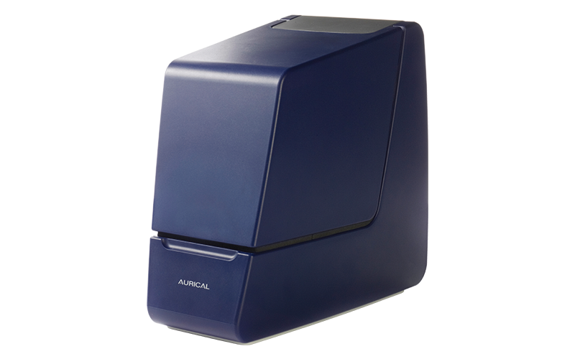
Coupler Response
Completed in Test Box without patient involvement

Slide 12
Please Note
When considering remote hearing aid fitting, especially in the cases of a new Direct Referral, the assessment appointment will often be undertaken without access to well-fitting earmoulds.
As a result, any hearing thresholds recorded will have been obtained from either headphones or preferably insert earphones, and the RECD measured using a foam-tip.
This practical guide will therefore assume that an insert foam tip and HA-1 coupler is used for both the coupler and ear portion of the measured RECD in a remote fitting pathway.
Notes:
12

Slide 13
Coupler Type (HA-1) ONLY
HA-1 for BOTH earmould <3mm vent and closed dome thin tube fittings.
RECD type should be set up HA-1 Tip if using foam tip to obtain RECD.
‘Apply the RECD to both ears’ enables RECD measured on one side to be applied to the contralateral ear. This can be considered if the outer and middle ear status is known to be the same. (Confirm with Tympanometry).
If reported outer or middle ear abnormalities or surgery exists then separate RECDs should be performed for each individual ear i.e. presence of perforation, persistent MEE or grommet (if no contraindications exist).
Notes:
13

Slide 14
HA-1 Coupler Response
Setting up for HA-1 Coupler (Using AURICAL Test Box)
HA-1 adaptor
1
2
3
Notes:
Select the circular disc which is known as the HA-1 Coupler (Image 1). Attach it to the coupling device until it clicks into place ( Image 2). Place the device in the test box and ensure it is place on the first port inside the test box ( Image 3)
14

Slide 15
HA-1 Coupler Response
Attach a medium insert foam tip to the RECD coupling tube and secure acoustic putty to the HA-1 adaptor.
Once the RECD probe is placed inside the Test box, click Measure Right/Let as appropriate.
Measured Coupler values will appear in the white boxes for the selected ear. Click OK to save the values.
Notes:
15

Slide 16
Normative Coupler Response
Normative Trace: Acceptable for both Moulds and Open Fits.
Abnormal Trace: Sound Leakage due to loose fitting foam tip in coupler. This will affect low frequency response. Ensure adequate tight seal and re-run the trace.
Very Abnormal Trace: Major sound leakage due to foam tip not inserting tight enough into the coupler and sealed inadequate seal with acoustic putty.
Notes:
16

Slide 17
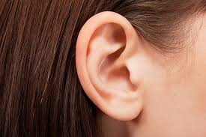
Ear Response
Completed in the Patient’s Ear
NB: Same contraindications apply to measuring ear response as they do for ‘insitu REMS’ and use of insert tips
Notes:
The Ear Response is the second measurement that needs to be completed to obtain a RECD. All Ear Measurements take place by clicking the ‘Ear Response’ button.

Slide 18
Probe Tube Calibration
Remove the RECD probe and RECD coupling from the test box.
Perform Probe Tube calibration for the RECD probe tube
Notes:
18

Slide 19
Foam Tip Insertion (Ear Response)
Connect the RECD coupling to a foam insert tip ensuring that a suitable size is used appropriate to the patients ear to prevent acoustical leakage.
A loose-fitting foam tip in the patient’s ear will result sound leaking out around the foam tip leading to negative RECD values in the low frequencies.
Notes:
19

Slide 20
Probe Tube Placement
Follow BSA (2018) REM procedure
Check for contraindications prior to probe tube insertion with Otoscopy.
Place the REM tube in the patient’s ears and perform Otoscopy to check probe tube placement.
The REM tube should be inserted within 5mm of the TM and 5mm past the insert tip.
Gender | Insertion Depth
Adult Females | 28mm
Adult Males | 30mm
Notes:
20

Slide 21
Foam Tip Placement
Do not use foam tip inserts where medically contraindicated including occluding wax, ear infections, discharge or other otological conditions.
Compress the foam tip and insert it over the probe tube, into the ear. Watch the black marker to make sure it stays at the notch. Ensure adequate seal and allow foam tip to expand.
Notes:
21

Slide 22
Foam Tip Placement
Ensure that the foam tip is given enough time to fully expand and consider using a larger insert tip if needed.
To run the ‘Ear Response’ ensure that the correct ear marker is selected.
Notes:
22

Slide 23
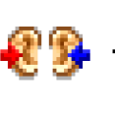
Normative RECD
Gently insert the probe tube. A notch in the gain curve above 4000 Hz is likely to be observed which is moving towards higher frequencies.
The probe tube is located correctly as soon as the notch is no longer pulling the gain curve down (-5 dB) in the high-frequencies.
Once a normative trace has been obtained, if suitable, copy RECD for the contralateral ear.
Notes:
Once you have obtained an acceptable Real Ear Response, the RECD measurement can be saved. The patient is able to leave the appointment now and is no longer required. The hearing aid/s can now be programmed remotely inside the test box.
23

Slide 24
Ear Response
The on-ear RECD component will usually be positive values when compared to the coupler values, expect a RECD of around 10 dB in the mid-frequencies.
Coupler Response
Measured RECD

Slide 25
Negative RECD
Notes:
25

Slide 26
RECD Troubleshooting
Loose-fitting insert foam tips: In this case, sound leaks out around the foam tip leading to negative RECD values in the low frequencies. Make sure the foam tip is given enough time to fully expand and consider using a larger insert if needed.
Shallow probe tube insertions. Negative RECD values may occur in the higher frequencies above 3000 Hz when the probe tube has not been inserted far enough into the ear canal.
Blocked probe tube: When RECD values are negative across the frequency range a blocked or crimped probe tube may be the cause. The tube could be blocked by wax or by incorrect placement of the tube against the ear canal.
Notes:
26

Slide 27
Middle Ear Problems
Presence of a patent PE tube or TM perforation: The larger ear canal/middle ear volume created by a patent PE tube or TM perforation creates a negative RECD value in the low frequencies. This not a concern as the effect of the perforation is unlikely to fluctuate.
Grommets: Take care if grommets are fitted as canal characteristics (and RECDs) will vary depending on the patency of the grommet.
Middle Ear Effusion (MEE): MEE will prevent sound entering the middle ear, resulting in a larger RECD. If MEE is persistent, you can use the measured RECD. If the effusion is transient, an average RECD may be more appropriate (or use the contralateral RECD if no effusion is present).
Notes:
27

Slide 28
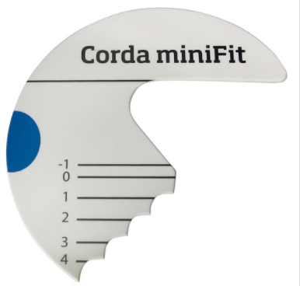
What Next: Thin Tubes
Once you have obtained RECD measurement for closed dome fittings, you will need to determine the patient’s individual thin tube size for each ear using the Corda MiniFit measuring tool appropriate to the hearing aid manufacturer as well as measuring the dome size.
Best practice would be to check the fit of tubing and dome size in the patients ears to ensure comfort and enable accurate fitting. Determine whether sports lock will be required.
Record measurement in patient’s journal.
Notes:
28

Slide 29
What Next: <3mm Vented Earmoulds
Once you have obtained a RECD measurement for earmoulds with <3mm vents, measure the distance between the centre of the ear canal opening and end of the hearing aid elbow.
Place the hearing aid behind the patient's ear– this is critical as the hearing aid can sit differently behind different ears, affecting tubing length.
It may not be exact but would be within 5mm and therefore the hearing aid should stay behind the ear.
This will need to be determined using a ruler or standardised prototype measuring tool that is wipeable in line with infection control.
Please document measurement for left and right ear accordingly in the patient’s journal as this measurement will be used when verifying the hearing aids with earmoulds in the coupler.
It is important that the ear mould tubing length is measured and accounted for each patient as this will affect the gain from the hearing aid when verifying in the test box.
Notes:
29

Slide 30
Coupler Verification in Test Box

Slide 31
Fitting Details
Ensure that when setting the fitting details page on Otosuite, the ‘Coupler Type ’ selected for ‘Measured RECD’ reflects the coupler used at assessment (HA-1 tip).
It is important to ensure that the fitting details page is set up correctly as the only impact of the RECD measurement for use of headphones will be in the correct selection of the ‘RECD Type’ and ‘Hearing Instrument Type. If those settings accurately reflect your fitting they will be accurately reflected in the target and the application of RECD.
Select the relevant acoustic parameters i.e. transducer, tubing, dome, measured RECD values if obtained at assessment etc) otherwise the accuracy of the fitting will be affected.

Slide 32
Closed Dome Thin Tube Fitting
With the HA-1 coupler, clinicians should be mindful about leakage when using putty to attach the device with the coupler.
Use patient’s thin tube size
1
5
2
4
3
Notes:
32

Slide 33
Closed Dome Thin Tube Fitting
Place acoustic putty onto the HA-1 coupler adaptor ensuring that the hole is not blocked (see image 2).
Attach some acoustic putty on to the thin tube wire, this will shift its resonance frequency and prevent it from vibrating and creating feedback during testing (see image 3).
Place the patient’s thin tube size into the HA-1 coupler adaptor so that the thin tube’s entry hole is flush with the underside of the adaptor.
Make sure that the acoustic putty is creating a tight fitting seal around the thin tube.
Position the hearing instrument horizontally on a piece of acoustic putty on the surface of the HA-1 adapter inside the test box.
Align the microphones along the loudspeaker axis and the reference microphone as close as possible to the front microphone of the hearing instrument without touching (image 5).
Close the lid and you are ready to start testing.

Slide 34
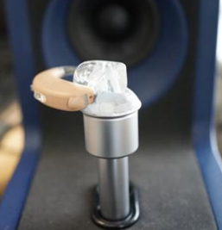
Earmould Fitting <3mm vents
Once the patient’s earmoulds have returned from the manufacturer, cut the tubing to the size measured and documented at assessment.
It is critical that the tubing length is cut before verification, to ensure the gain is correct when worn by the patient.
Once cut to appropriate length, attach earmould to hearing aid and place on HA-1 coupler using acoustic putty.
Align the microphones along the loudspeaker axis. It is important to align the test box reference microphone and hearing device microphone appropriately to avoid measurement error. Position the reference microphone as close as possible to the front microphone of the hearing instrument without touching.
Close the lid. You are ready to start testing.

Slide 35
Verification
Measure the hearing aid output inside the test box at:
50dB SPL, 65dB SPL AND 80dB SPL using ISTS signal
Ensure responses are made in SPL format.
Ensure output does not exceed uncomfortable loudness levels by running the 0SPL90 warble tone sweep and adjusting the MPO where appropriate.
Take care with the low frequency gain when verifying for thin tube/wire hearing aids. For low frequencies (1kHz and below) be cautious not to move too far from the click-fit starting point, even if the target is requesting much more low frequency gain. The clinician is advised to sense check the target against the hearing loss to spot a spurious element to the low frequency target.

Slide 36
References
Aurical HIT and the Otosuite HIT Reference Manual. (2015). Otometrics [Online]. Available at: https://madsen.hu/pdf/utmutato/Aurical_HIT_Reference_Manual_7-50-1150-EN_04.pdf
Baggatto, M., Moodie, S., Scollie, S., Seewald, R., Moodie, S., Pumford, J., Liu, K. (2005). Clinical Protocols for hearing instrument fitting in the Desired Sensation Level method. Trends in hearing: 9(4): 199-226.
Baggato, M. P., Seewald, R.C., Scollie, S. & Tharpe. AM. (2006), Evaluation or a Probe-Tube Insetion Technique for Measureing the Real-Ear-to Coupler Difference (REC) in Young Infants.’ J Am Acad Audiol 12(8), 573-581.
Beck, D., (2209). DSL, RECD, and Pediatric Amplification: Interview with Ricahrd C.Seewald, PhD ; Available at: http://www.audiology.org/news/interviews/Pages/20090113a.aspx [Accessed December 08, 2019]. BS ISO 12124:2001. Acoustics: Procedures for the measurement of real-ear acoustical characteristics oh hearing aids.
British Society of Audiology (2018) Recommended Procedure: Practice Guidance Verifcation using probe microphone measurements. Available at: https://www.thebsa.org.uk/wp-content/uploads/2018/05/REMS-2018.pdf [Accessed December 08 2019).
British Society of Audiology/British Academy of Audiology (2021). ‘Setting and verifying the frequency response of a hearing aid remotely for adults during periods of restricted service delivery.’ [Online]. Available at: https://www.baaudiology.org/app/uploads/2021/02/BAA-BSA-remote-fitting-guidance_Publish.pdf [Accessed 7th February 2021].
Dworsack-Dodge, M. and Kossek, P. (2012). RECD and CBF made easy with the new AURICAL, Otometrics.
Gustafon, S. Pittman, A. and Fanning, R. (2013). ‘Effects of Tubing Length and Coupling Method on Hearing Threshold and Real-Ear to Coupler Difference Measures’ American Journal of Audiology, 22(1), pp.190-199.
Lantz, J. Jensen, O.D. Haastrup, A. and Olsen, S. Ø. (2007). ‘Real-ear measurement verification for open, non-occluding hearing instruments,’, International Journal of Audiology, 46(1), pp. 11-16. DOI; https://doi.org/10.1080/14992020601083313 [Accessed 7th February 2021].
Munro, K.J. (2004). Update on RECD measures in children. In: Seewald RC, Bamford J, eds. A Sound Foundation through Early Amplification: Proceedings of the 3rd International Conference. Stäfa, Switzerland: Phonak AG, 71-89.
Munro, K.J., Toal, S. (2005). Measuring the Real-Ear to Coupler Difference Transfer function with an insert Earphone and a Hearing instrument: Are they the same? Ear and Hearing. 26;27-34.
Oticon (2017). ‘Fitting Opn for persons with tinnitus: White Paper [Online]. Available at: https://wdh01.azureedge.net/-/media/oticon/main/pdf/master/opn/23975uk_wp_tinnitus_opn.pdf?la=en&rev=344E&hash=DA0D056D74C113FDC8BE60291484C7C1 [Accessed 7th February 2021].

Slide 37
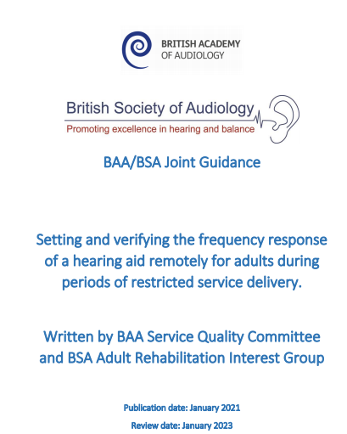
Key Documents

Slide 38
Contact
Perindi Patel
perindi.patel@nhs.net
NHS Audiologist
Shropshire NHS Audiology Services

