Slide 1
National study of adult cochlear implant referrals: which eligible patients are being missed for CI assessment?
Presenting Authors: Jameel Muzaffar & Chloe Swords
Co-authors: CIRCA Study Group, coordinated by INTEGRATE
BCIG Meeting 14/04/2023
Notes:
Good afternoon. I’m Jameel Muzaffar and in a change to scheduled billing I’m filling in for Chloe Swords who can’t join us as she’s just had a baby, to present word from the CIRCA study group which has been coordinated by INTEGRATE, the UK ENT Trainee Research Collaborative. We’re very grateful for the invitation to present the results of the national CI referral project which I know many of you in the audience have taken part in. Or put another way, we’d like to share with you what data from 6000 patients can tell us about who is missing out on cochlear implant referrals and which factors make this more or less likely.

Slide 2
Background
Cochlear implantation is a cost-effective treatment for severe to profound hearing loss¹
Governed by NICE guidance TA566 – updated in March 2019²
Previous work suggested that significant numbers of potentially eligible patients not referred for assessment³
CI champions scheme⁴
Andries E, Gilles A, Topsakal V, et al. Systematic Review of Quality of Life Assessments after Cochlear Implantation in Older Adults. Audiol Neurotol. Published online July 10, 2020:1-15. doi:10.1159/000508433
NICE guidance TA566 https://www.nice.org.uk/guidance/ta566
Raine C. Cochlear implants in the United Kingdom: Awareness and utilization. Cochlear Implants Int. 2013;14(Suppl 1):S32-S37. doi:10.1179/1467010013Z.00000000077
CI champion scheme: https://www.baaudiology.org/professional-information/cochlear-implant-champions/
Notes:
1.2 million people in the UK suffer from severe-to-profound hearing loss, and cochlear implantation forms the mainstay of surgical treatment. The NICE guidance governing implantation were updated in March 2019 to become inclusive of more patients. Despite the fact that implantation is well recognised as improving functional performance and quality of life, previous work has shown that many patients potentially within criteria are not being referred for assessment. To counter this, the British cochlear implant group and BAA launched the CI champions scheme in 2019 to ensure all eligible adults and children are well-informed about CI and offered a timely referral at every ENT/audiology unit.

Slide 3
Aims & Objectives
To assess UK nationwide patterns in adult CI referrals
Primary outcome(s)
To identify potential predictors of referral for assessment
Secondary outcome(s)
To identify potential predictors of discussion of assessment
i.e., are eligible patients being informed that they could be referred for a CI assessment?
Notes:
With this in mind, this project aimed to understand the national picture of referral patterns, and to assess the proportion of adults meeting NICE audiometric criteria for CI assessment that are referred. We wondered whether there were factors that might increase or decrease likelihood of referral or discussion. By discussion, I mean are patients who are eligible for CI assessment being told that they could be referred for one?

Slide 4
Methods
National retrospective audit of patients seen in NHS secondary care ENT/Audiology units between July and December 2021
Site teams made up of ENT trainees, Consultants, Audiologists and Audiovestibular medicine
Ran AuditBase Crystal Report developed by Auditdata and Cochlear®
Identifies all patients eligible for CI
Exclusion: <18 year old, referred to CI centre from another secondary care facility
Retrospective review of Audiology/Auditbase notes, clinic letters and hospital notes:
Were patients REFERRED for a CI?
Were patients informed/DISCUSSED that they were eligible for a CI?
Patient ‘predictors’
Site leads completed hospital information form
CI centre, CI champion, distance to nearest CI centre
Sent anonymised data to INTEGRATE for data collation/analysis
Notes:
This project took the form of a national retrospective audit, coordinated by INTEGRATE with data collected by local site teams. Once signed up, site teams were sent instructions on how to setup and run a report on auditbase, which identifies all patients eligible for a CI in a given time period. In this case, it was the 6 months from July to December 2021. Once a list of patients were generated from each site, site teams retrospectively trawled through audiology notes, clinic letters and hospital notes to elucidate whether patients had firstly been referred for a CI, whether they were told they were eligible for CI assessment and a number of patient predictors. These included past medical history, age, gender, ethnicity and patient postcode. The latter was converted into the indices of multiple deprivation, which is a proxy indicator of how deprived a region that a patient lives in. Site leads also indicated some hospital specific factors such as whether they were CI centres or had CI champions. The anonymised data was sent through to me and underwent collation and analysis.

Slide 5
Data analysis
Excluded duplicates
Baseline characteristics – means or proportions (chi-squared test or ANOVA)
Backward stepwise logistic regression model to explore predictors for both primary & secondary outcomes
Odds ratios + 95% confidence intervals
p<0.05 considered statistically significant
SPSS software version 28.0 (Cary, NC)
Notes:
A univariate and multivariable binary logistic regression model was used to assess the relationship of variables with the primary and secondary outcome. The multivariable model adjusted for socioeconomic, ethnic, clinical and hospital factors.

Slide 6
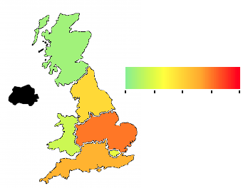
Results – Centres
Distribution of recruited patients, by region
36 centres
+17 sites ineligible as Practice Navigator
6760 patients -> 6587 once duplicates removed
9 (25%) CI centres
CI champion was present in 27 sites (74%)
41% had 0 hours per month for the role
3.5%
19.2%
0 10 20 30 40
Percentage of patients recruited, by region
6.3%
30.4%
11.5%
25.8%
Notes:
36 centres submitted data across England, Scotland and Wales, although we can see that the majority of data came from England. Data from 6760 patients was initially submitted, which reduced to 6587 once duplicates were removed. One quarter of sites performed cochlear implantation, and three-quarters had a CI champion. However, 41% of CI champions did not have any dedicated non-clinical time for this role.

Slide 7
Key findings
Disparities in outcomes:
Socioeconomic status
Ethnic backgrounds
Age & sex
Comorbidities
Hospital factors
36% of patients had documented discussion informing them of their eligibility
9% of eligible patients referred for assessment
Notes:
Before discussing these findings, let’s remember that the auditbase report identified only patients who were eligible for a cochlear implant. With that in mind, this study showed that nationally only one third of eligible patients had a documented discussion informing them that they were eligible for an assessment. Further to this, only 9% of all eligible patients proceeded to be referred for CI assessment and potential implantation.
Even more so, when we analysed these results using an adjusted multivariable logistic regression model, we saw key disparities in outcomes. These were present across a range of different factors, which I will now discuss.

Slide 8
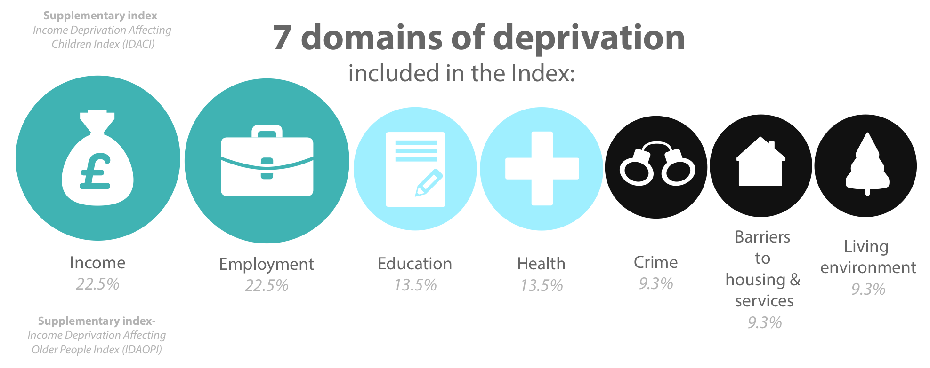
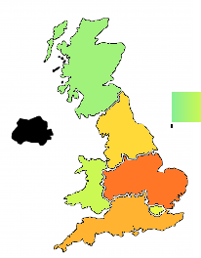
Socioeconomic & geographic factors
Patients from LEAST deprived locations
MORE likely to be referred
(Least deprived region OR 2.12 (1.28-3.5), ref: most deprived location)
MORE likely to have a discussion
(Least deprived region OR 1.45 (1.09-1.92), ref: most deprived location)
Geography
From London LEAST likely to be referred
(OR 0.41 (0.29-0.59), ref: Midlands)
From the North & London LEAST likely to be discussion
(OR 0.73 (0.61-0.87) & OR 0.43 (0.34-0.54), ref: Midlands)
Notes:
Remember that all these odds ratios are derived from an adjusted multivariable regression model.
Firstly, looking the socioeconomic data is derived from patient postcodes. The government publishes data regarding IMD which are comprised of 7 domains and ranks patients according to how deprived the region that the live in is. There are over 32,000 different regions in total. This can be divided into deciles, whereby 1 is the most deprived region and 10 the least. This data showed that patients who live in the least deprived locations are twice more likely to be referred for a CI and 1.4 times more likely to be told they are eligible.
Secondly, geography was important too. Patients who lived in London were 60% less likely to be referred for a CI than someone from the Midlands and Eastern region; and those who lived in the North or London were 30% and 55% less likely to be told they were eligible.

Slide 9
Ethnicity
Minority ethnic background LESS likely to be discussed than white patients
Asian: OR 0.57 (0.42-0.76), ref: white
Black: OR 0.55 (0.33-0.89), ref: white
BUT No influence on likelihood of referral
Notes:
Next, when we turn our attention to ethnicity, Asian or Black patients were over 40% less likely to be told they were eligible for a CI than white patients. Although there was no difference in likelihood of referral.

Slide 10
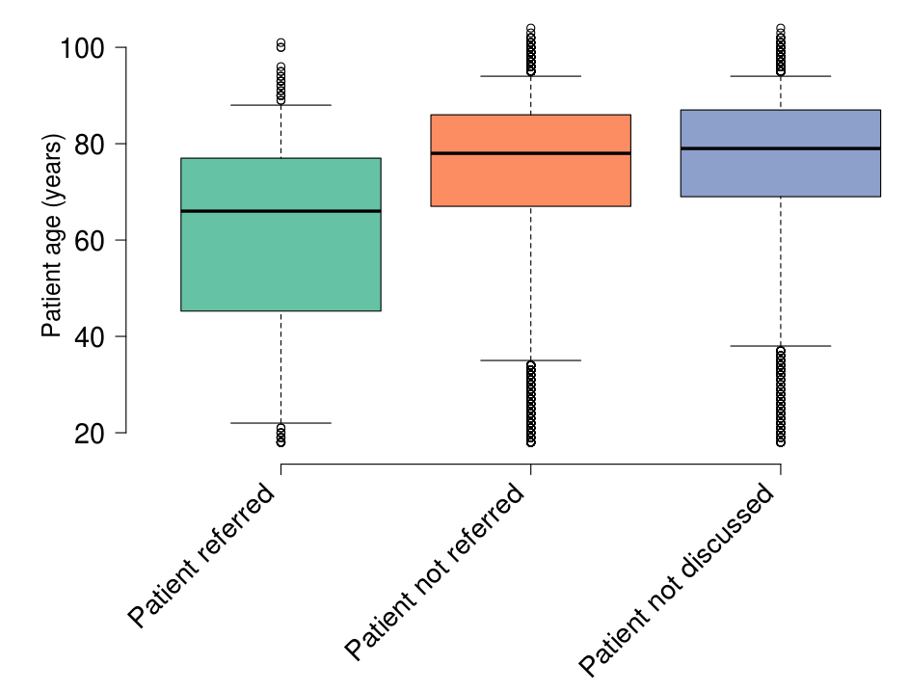
Other interesting predictors
LESS likely:
Older adults
Referred: OR 0.97 (0.97-0.98) p<0.001
Discussed: OR 0.98 (0.98-0.98) p<0.001
Male
Referred: OR 0.71 (0.63-0.8), ref: women
Discussed: OR 0.64 (0.52-0.78), ref: women
MORE likely:
Index PTA at CI centre
Referred: OR 5.96 (4-72-7.43), ref: not CI centre
Discussed: OR 3.01 (2.58-3.5), ref: not CI centre
Profound hearing loss
Referred: OR 3.11 (1.61-6.03), ref: severe loss
Discussed: OR 1.34 (1.04-1.73), ref: severe loss
CI champion
Referred: OR 0.84 (0.69-1.02), ref: no champion
Discussed: OR 3.86 (3.16-4.71), ref: no champion
Notes:
And finally, I’ve picked out a couple of interesting predictors. We saw that both age and gender were important factors, whereby older patients were less likely to be referred. In fact for every one year of advancing age, the odds of being referred reduced by 0.97. And we saw that men were less likely to be discussed or referred than women.
The following factors are positive predictors. So patients who had their index audiogram at a CI centre were 6x more likely to be referred and 3x more likely to be discussed than those seen elsewhere. Patients with profound hearing loss, even across one eligible hearing frequency were 3x more likely to be referred and 1.3x more likely to be discussed than someone only meeting criteria because they had severe hearing loss. Finally, having a CI champion on site conferred a 4x greater likelihood of being discussed, but patients were no more likely to be referred.

Slide 11
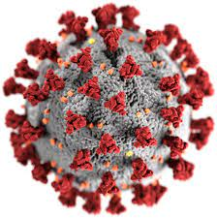
Discussion
Multiple disparities in care
Limitations
Retrospective note analysis over 6 months
Were patients representative of UK population?
Lower representation from Scotland & Wales; no NI sites
Notes:
This project has shown multiple disparities in care at the moment, although there are some key limitations to consider, namely that this data was retrospectively collected in a 6 month period in 2021, and there was a proportionately higher representation from England.

Slide 12
What next?
Easy wins
BCIG/BAA recommendations – CI champion¹
Dissemination of results
Longer term
Encourage regular re-audit using AuditBase report
Automatic alerts on AuditBase
Increase capability and capacity in departments
CI champion scheme: https://www.baaudiology.org/professional-information/cochlear-implant-champions/
Notes:
The key is though to address how we are going to act upon these findings. Firstly, the 25% of sites that don’t currently have a CI champion, could consider appointing somebody as per the BCIG and BAA recommendations. But the long-term is key. Now that we have helped support the setup of this AuditBase report in at least 36 centres nationally, regular re-audit should be encouraged to identify new eligible patients. Perhaps though a better system could be to work with AuditBase to incorporate automatic pop-up alerts telling clinicians when a PTA is performed that makes patients potentially eligible for assessment. And finally, we do need to take a look at increasing capability and capacity in CI centres, both in terms of potentially increased assessments and surgery.

Slide 13
Conclusions
100%
Significant room for improvement (36% had a discussion and 9% referred for assessment)
Inequalities
Notes:
In conclusion, there is a significant room for improvement of how we manage patients eligible for Cis, and we must be aware of the inequalities indicated by this report. It is troubling to me to see this percentage of 36%, which really we should be striving to be 100% if we aim to practice by the edict of “no decision should be made about me, without me”.

Slide 14
Collaborators
Project Management Team (alphabetical): James Arwyn-Jones, Hannah Blanchford, Reshma Ghedia, John Hardman, Eliot Heward, Kris Milinis, Alistair Mitchell-Innes, Jameel Muzaffar, Delphine Nkuliza, Chloe Swords
Expert Advisory Group (alphabetical): Manohar Bance, Rhian Bardsley, Sam Cho, Helen Cullington, Ann-Marie Dickinson, Susan Eitutis, Charlie Huins, Colin Leonard, Rishi Mandavia, Nishchay Mehta, Peter Monksfield, Irumee Pai, Matthew Smith, Emma Stapleton, Carl Verschuur, Deborah Vickers, Katherine Wilson
Regional Leads (alphabetical): Javier Ash, Hannah Blanchford, Quentin Bonduelle, Richard Brown, Han Cao, Matthew Farr, Cillian Forde, Charn Gill, Elliot Heward, Peter Kullar, Colin Leonard, Kris Milinis, Faith Protts, Asil Tahir, Charlotte Thomas
Notes:
Thank you to our many collaborators and site teams.

Slide 15
Site leads
Aakash Amlani, Aaron Trinidade, Ajmal Masood, Alastair Mace, Alistair Mitchell-Innes, Amina Hussain, Andrew Hall, Anirvan Banerjee, Ann Darvill, Anushri Patel, Anna Pepler, Arshad Zubair, Azhar Shaida, Anitha Thirumalaivelu, Bernadette Parker, Charlotte Thomas, Chloe Swords, Muhammed Talha Suleman, Muhammed Talha Suleman, Sadie Khwaja, Rumannah Chothia, Harry Powell, Shiraz Jamshaid, Konstantinos Paraschou, Rhian Bardsley, Arunachalam Iyer, Mehaab Jaffer, Irene Benaran, Joanne Lydon, Christy Davidson, Ciaran Walsh, Clair Saxby, Claire Lingard, David Selwyn, Debbie Corbett, Derrick Siau, Dipan Mistry, Dominic Ip, Dora Amos, Ellie Morriss, Eniola Salau, Eyal Schechter, Farhana Begum, Gareth Smith, Graham Vosper, Hannah Blanchford, Helen Brough, Helen Beer, Holly Whittaker, Judith Osuji, Jack Sandeman, James Bartram, James Tuck, Janneil Mitchell, Javier Ash, Jayesh Doshi, Jennifer Fahy, John Murphy, Jonathan Butler, Jonathan Clarke, Jonathan Lee, Joseph Blackaby, Karlien Van Staden, Kevin Kulendra, Kim Hui Lim, Kim Hui Lim, Kityee Chan, Kostas Tsioulos, Laura Burton, Linnea Cheung, Lisa Hunter, Lisa Kennedy, Lorraine Lewis, Louis Riley, Misha Verkerk, Mariam Moghal, Mark Chung, Matthew Ryan, Matthew Smith, Matthew Trotter, Megan Allman, Michel Abou-Abdallah, Mohamed shaker, Nicaida Huggins, Owen Judd, Perindi Patel, Philip Gomersall, Peter Valentine, Rebecca Carpenter, Rebecca Christmas, Rhys Palfrey, Rupan Banga, Salim Suleman, Sara O'Neill, Sarah Creeke, Shalini Menon, Soo Oh, Sreedharan Nair Vijayanand, Suzanne Jervis, Terry Cuff, Usama Kamel, Usha Chittathur, William Tsang, Yohanna Takwoingi, Mama Ntiriwa Sekyi-Djan, Mohammed Yousif, Mohit Achanta, Muhammad Riaz Khokhar, Mustafa Thamer, Olivia Wharf, Razan Basonbul, Richard Brown, Ryan Perkins, SS Sara Badrol, Shilpa Divakaran, Swagatam Banerjee, Yousef Ibrahim, Sajida Julfa, Annette Hill, Andrew Rutter, Wacas Ghafoor, Charndeep Gill, Islam Soltan, Jenny Boswell, Amina Bibi, Alice Roberts, Chritine du Plessis, Michael Elliott, Quentin Bonduelle

Slide 16
Any questions?
Notes:
Particular thanks to the BSO, who funded the study via their Small Grants scheme and the British Cochlear Implant Group, who provided the Auditbase report tool

