Slide 1
Audiometry and cochlear implant candidacy referrals: To 3 or not to 3?
Catherine Killan^{1,2,3}, Douglas Hartley^{1,2,4}, Derek Hoare^{1,2}, Pádraig Kitterick^{1,2,4,5}
¹ NIHR Nottingham Hearing Biomedical Research Centre, University of Nottingham, Nottingham, UK
² Hearing Sciences, School of Medicine, University of Nottingham, Nottingham, UK
³ Bradford Teaching Hospitals NHS Foundation Trust, Bradford, UK
⁴ Nottingham University Hospitals NHS Foundation Trust, Nottingham, UK
⁵ National Acoustics Laboratory, Sydney, Australia
Acknowledgments: Paige Church, Jason Cropper, Rob Gardner, Faye Isherwood, Sophia Nasim, Nathan Waite, Karen Willis.
The CUSP study was funded by NIHR and Cochlear Corp.

Slide 2
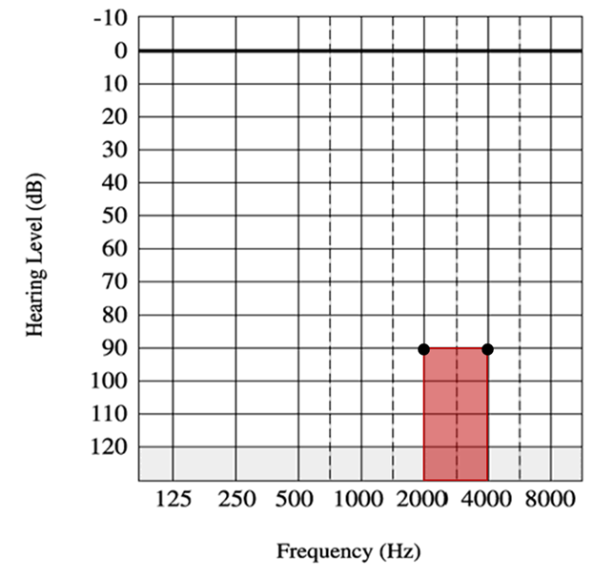
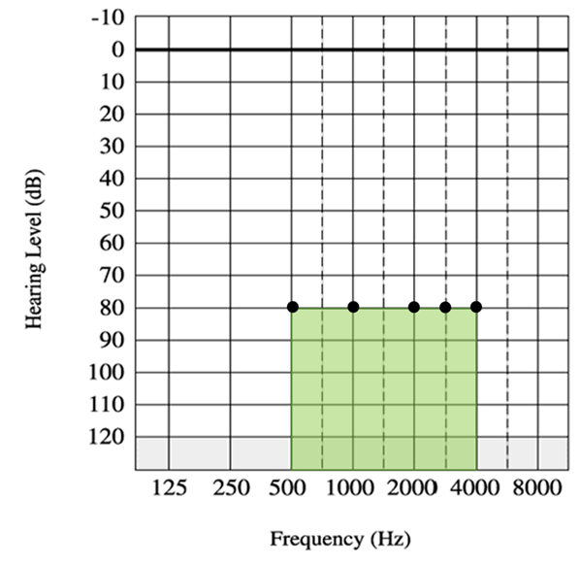
TA166 and TA566 Audiometric criteria
Any two thresholds
TA166 (2009)
TA566 (2019)
Audiometric eligibility could be established by measuring 4 thresholds.
Audiometric eligibility can be established by measuring from 4 up to 10 thresholds.

Slide 3
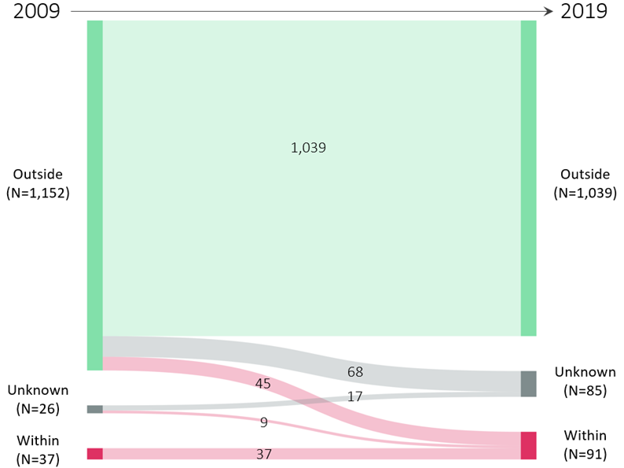
Impact on eligibility of children using HAs
We looked at the two most-recent audiograms of whole caseloads of children using hearing aids (HAs) at four hospitals from 2019-2021.
The 2019 NICE guidance (TA566) made more children audiometrically eligible for CIs.
It also meant more children’s eligibility became unknown, because of the extra thresholds needed to know if a child met the guidance.

Slide 4
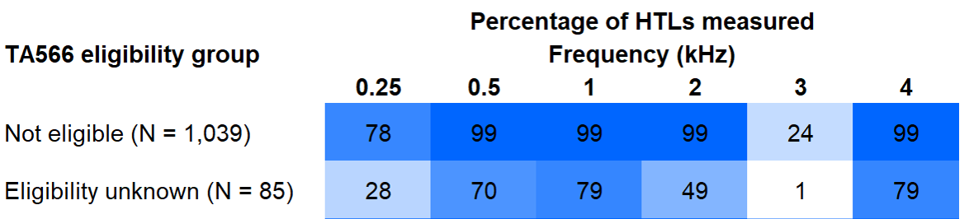
Characteristics of children whose eligibility was unknown
Children whose eligibility was unknown were:
Younger on average
More likely to have additional needs

Slide 5
Aural / Oral outcomes of children whose eligibility was unknown
PEACH questionnaire* completed by 107 parents
Statistics controlled for age, caregiver education, and additional needs
Children of unknown eligibility scored:
worse than CI users by 18% on average (p<0.01)
worse than HA users out of NICE audiometric criteria
similarly to children using HAs newly eligible for CIs
16% equivalent to difference between a 50 dB HL and 80 dB HL hearing loss*
*Ching T., & Hill, M. (2007). The Parents’ Evaluation of Aural/Oral Performance of Children (PEACH) Scale: Normative Data. J Am Acad Audiol 18: 220-235

Slide 6
Possible consequences for patients
Not referred to CI services, because referral guidance is the same as the NICE guidance
Delayed referral
Inequitable access for those with additional needs
Delays risk missing the chance of having bilateral CIs for older teenagers

Slide 7
Next steps for CI Champions
When thresholds at 3 kHz are known:
Include 3 kHz when deciding whether to offer referral to CI service
When thresholds at 3 kHz, or other frequencies that could affect eligibility, are unknown:
Measure if possible
Speak with your CI service about whether to refer anyway
Promote measurement of 3 kHz – adults and children
Raise awareness that adults with learning difficulties might be on children’s caseloads

Slide 8
Next steps in research and audit
Audit TAG566 (NICE, 2019)
Create evidence for next NICE guidance…
COACH Trial – Recruiting now!! Seeking adults with:
any two thresholds ≥70 dB HL (0.5, 1, 2, 3, or 4 kHz) bilaterally
Please visit our website to find out more
www.coachtrial.ac.uk
If your department would like promotional material, or to become a patient identification centre, please email the COACH Team at:
COACH@Nottingham.ac.uk

Slide 9
Can we make the referral guidance clearer?
Please email any suggestions to catherine.killan1@nottingham.ac.uk and I will share with the BCIG Trustees

