Slide 1
Cochlear implants
and congenital hearing loss
Nicola Clarke
The Emmeline Centre, Cambridge

Slide 2
Session aims:
Predominantly adult focused
To understand the variations within the congenital hearing loss population, and how they may effect patient outcomes.
To gain insight into the methods/tools CI center's commonly use to predict CI outcomes for congenitally deaf candidates
To understand the associated challenges with cochlear implantation in congenitally deaf patients
To gain clarity on your role as a referrer for this patient group
BCIG 2023: Cochlear implants and congenital hearing loss

Slide 3
Defining congenital hearing loss: Long term profound hearing loss
But variations within this definition:
Progressive vs non-progressive
Hearing aid history
Mode of communication
Deaf/deaf identity and community
Insert adult based hearing aid pic
BCIG 2023: Cochlear implants and congenital hearing loss
Notes:
These issues are explored in depth in the CI assessment process.

Slide 4
Motivations…… why now?
What are they expecting?
Previously declined a referral, now wants to go ahead
“To talk normally”
A new life event
e.g. new job, new hearing partner, first child
A peer has recently been implanted with good outcomes
“Nothing to lose”
“So I don’t need to sign anymore”
BCIG 2023: Cochlear implants and congenital hearing loss

Slide 5
Predicting outcomes
Progressive loss (memory for sound)
Post lingual profound deafness
Support from family/friends
Environmental Sounds
Awareness of speech sounds, prosody and intonation
Use of voice to aid lipreading
Access to music
I
N
D
I
C
A
T
O
R
S
Strong motivation, flexibility and appropriate expectations
Access to sound in environment after implantation, and not living in a ‘silent world’
BCIG 2023: Cochlear implants and congenital hearing loss

Slide 6
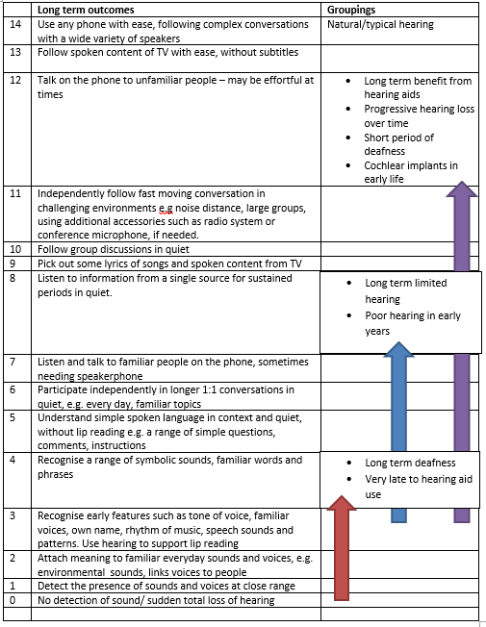
Auditory Staircase
Nottingham Auditory Implant Programme, 2018
Tools to support expectations counselling
BCIG 2023: Cochlear implants and congenital hearing loss

Slide 7
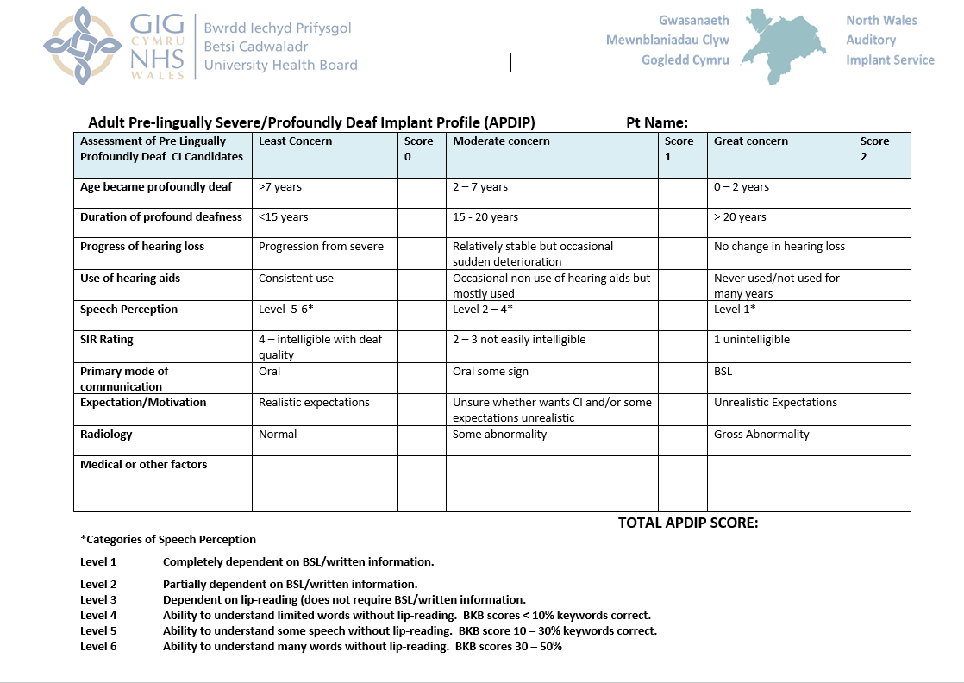
Tools to support expectations counselling
BCIG 2023: Cochlear implants and congenital hearing loss

Slide 8
“To talk normally”:
Likely no noticeable difference to speech articulation
Revisiting those expectations…..
Previously declined a referral, now wants to go ahead:
What has changed? Are expectations appropriate?
A new life event
e.g. new job, new hearing partner, first child:
Ensure expectations around communication skills are appropriate
“So I don’t need to sign anymore”:
A CI will not change main method of communication
“Nothing to lose”:
May not be true, may make good use of auditory signal with hearing aids, CI may not provide much more functional benefit
A peer has recently been implanted with good outcomes:
Discuss hearing history and how it affects outcomes
BCIG 2023: Cochlear implants and congenital hearing loss

Slide 9
Common challenges:
Deaf community and change in identity (counselling options)
Programming challenges- NAS, high frequency intolerance
Difficulties with concepts of pitch and volume, and giving feedback on sound
Auditory memory deficits
Consistency of wear
Commitment to rehabilitation
Misalignment of expectations
BCIG 2023: Cochlear implants and congenital hearing loss

Slide 10
Considerations for paediatric congenital hearing loss:
Profound loss usually identified by newborn hearing screen
Age of implantation will affect outcomes- pre or post lingual
Managing expectations/counselling of parents is crucial, particularly the impact of implantation on speech and language skills
BCIG 2023: Cochlear implants and congenital hearing loss

Slide 11
What is your role as a referrer?
Setting appropriate expectations early
It is never too late to refer if expectations and motivations are appropriate (but worth checking the referral criteria of your local centre)
Prepare the patient for the importance of consistent wearing of hearing aids, even if it provided little benefit- need to stimulate auditory nerve and get used to the routine of wearing equipment
We will provide all the information required, just please help us to explore motivations and set appropriate expectations from the very beginning
BCIG 2023: Cochlear implants and congenital hearing loss

Slide 12
BCIG 2023: Cochlear implants and congenital hearing loss

Slide 13
Nicola Clarke
Senior Hearing Rehabilitationist /
Speech and Language Therapist (Adults)
Email
Nicola.clarke60@nhs.net
Telephone
07955 433 798
Web
www.cuh.nhs.uk/our-services/emmeline-centre-for-hearing-implants
BCIG 2023: Cochlear implants and congenital hearing loss

Slide 14
References
Auditory performance and subjective benefits in adults with congenital or prelinguistic deafness who receive cochlear implants during adulthood. Duchesne, L et al., Cochlear implants international. 18(3):143-152, 2017
Pushing the boundaries: ‘Is it ever too late for an implant?’ Fields S et al., Cambridge, 2014
Cochlear implantation in early deafened, late implanted adults: Do they benefit? Kumar, RS et al., Cochlear Implants International. Vol. 17 Suppl 1, pp. 22-5, 2016
Relationship between APDIP Score and Outcomes in Pre-Lingually Deafened Cochlear Implant Users. Jenny Townsend AuD, Head of Auditory Implantable Devices North Wales Cochlear Implant Programme.
References
BCIG 2023: Cochlear implants and congenital hearing loss

