Slide 1
The use of TEN testing in CI candidacy
Kirsty Ellis
Adult Clinical Scientist
Yorkshire Auditory Implant Service, Bradford

Slide 2
What is a dead region?
A dead region is a part of the basilar membrane where there are no functioning inner hair cells and or/neurones.
However, a patient may still respond on a hearing test at a frequency where there is a dead region due to off frequency listening.
If a sound is sufficiently loud enough it will cause vibration across a larger area of the basilar membrane and can stimulate across other inner hair cells that are not tuned to that particular frequency.
Prevalence of a single dead region in patients with sensorineural losses 36%, extensive dead regions present 3% cases (Pepler et al., 2014).

Slide 3
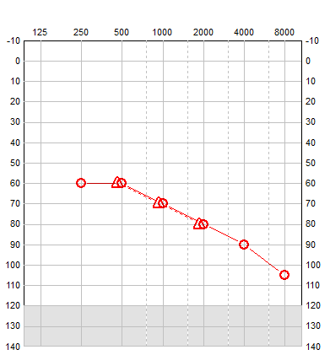
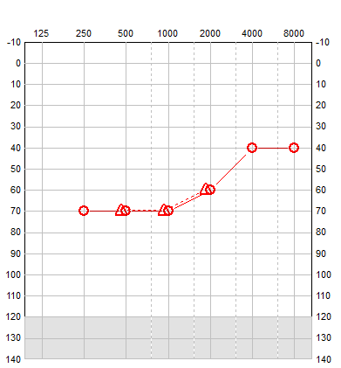
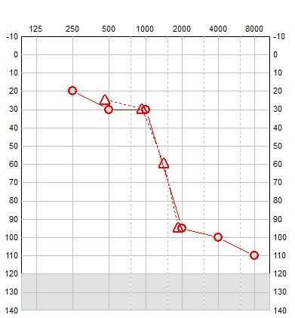
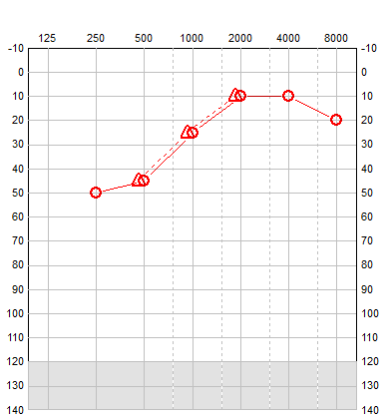
Consider dead regions when…
The absolute threshold is 70 dB HL or greater
Low frequencies >50 dB HL
High frequencies <50 dB HL
Low frequencies 40-50 dB HL
High frequencies <20 dB HL
>50 dB per octave change in threshold
(Moore, 2007)

Slide 4
Diagnosis: The TEN test
TEN (Threshold Equalizing Noise) presents a masking noise in the test ear alongside a pure tone.
First measure the pure tone threshold without TEN noise, then measure the threshold in the presence of the TEN noise.
The degree the threshold is elevated provides an indication on whether a dead region is present.
Can test hearing losses up to 90 dB HL.

Slide 5
Interpretation of TEN results
For those patients with a dead region we expect their threshold to increase dramatically in the presence of a dead region.
The criteria for identifying a dead region is:
Masked threshold 10dB or more above the TEN level
AND
Masked threshold 10 dB or more above the Absolute Threshold
(Vinay & Moore, 2020; Moore, 2001)

Slide 6
How to perform the test
TEN test can be performed from 0.5-4kHz.
First measure Absolute threshold- PTA in 2 dB steps.
Introduce TEN noise
70 dB for losses below 60 dB HL
10 dB sensation level for 60-80 dB HL
90 dB for losses at 80-90 dB HL
90 dB is MAX TEN level (or ULL)
Re-measure threshold in 2dB steps- this is the Masked Threshold

Slide 7
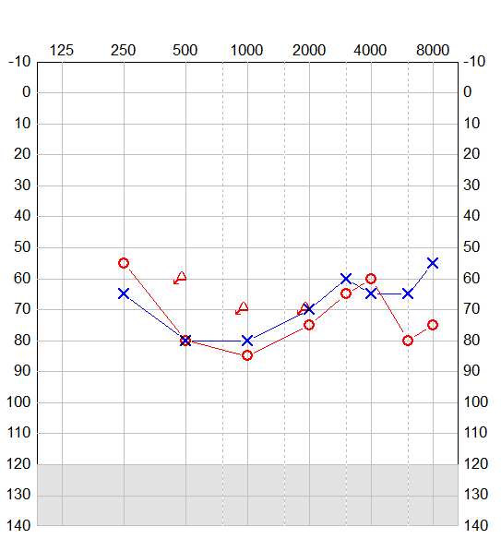
Example
Patient who has been performing below expectations although optimally aided.
Mid frequency dead regions identified at 1 and 3kHz
Right ear
Frequency (Hz) | 1000
Absolute threshold | 86
TEN noise level | 90
Masked threshold | 104
Dead Region? | Y

Slide 8
How we can use TEN testing
Limit amplification into area of dead region (Moore, 2000).
No amplification above x 0.57 edge frequency for low frequency dead region
No amplification above x 1.6 above edge frequency for high frequency dead region
Works best alongside aided speech testing
Is the patient performing worse than expected for their audiogram?
Why is the patient performing worse than expected?
Can justify cochlear implant referral/implantation when PTA doesn’t meet NICE criteria(Shrivastava et al, 2020).

Slide 9
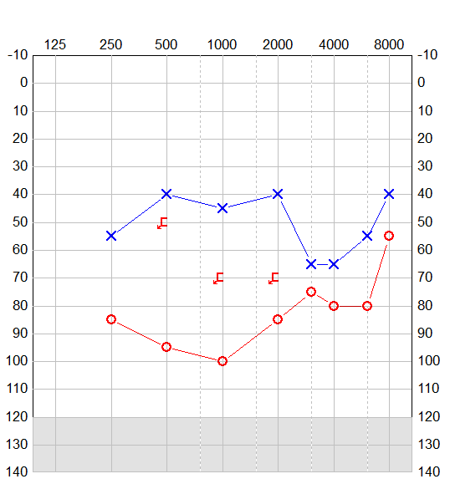
Case study- Dead regions identified at 1, 3 and 4 kHz in left ear (unable to test right).
46 year old man, 7 year history of progressive hearing loss.
Test | Pre implant | Post implant
BKB sentences @70 dB A | 10% aided bilaterally | 100% right implant alone
AB words @ 70dB A | 27% phonemes aided bilaterally | 83% phonemes right implant alone

Slide 10
Summary
Audiograms do not always give accurate prediction of functional performance.
Although certain shapes of audiogram can be an indicator of dead regions this is not always the case.
TEN testing is a fast method of diagnosing dead regions and is a useful addition to complex/severe and profound Audiology services and cochlear implant assessments alongside speech testing.
Any questions??

Slide 11
References
Moore, B.C., 2000. Audiometer Implementation of the TEN (HL) Test for Diagnosing Cochlear Dead Regions. White Paper.
Moore, B.C., (2001). Dead regions in the cochlea: Diagnosis, perceptual consequences, and implications for the fitting of hearing aids. Trends in amplification, 5(1), pp.1-34.
Moore, B.C., (2007). Prevalence of dead regions in subjects with sensorineural hearing loss. Ear and hearing, 28(2), pp.231-241.
Pepler, A., Munro, K.J., Lewis, K. and Kluk, K., (2014). Prevalence of cochlear dead regions in new referrals and existing adult hearing aid users. Ear and hearing, 35(3), pp.e99-e109.
Shrivastava, M.K., Eitutis, S.T., Lee, J.W., Axon, P.R., Donnelly, N.P., Tysome, J.R. and Bance, M.L., (2020). Hearing outcomes of cochlear implant recipients with pre-operatively identified cochlear dead regions. Cochlear implants international, 21(3), pp.160-166.
Vinay, Sandhya and Moore, B.C., 2020. Effect of age, test frequency and level on thresholds for the TEN (HL) test for people with normal hearing. International Journal of Audiology, 59(12), pp.915-920.

Slide 12
Further Reading the STR (signal-to-TEN-ratio)
Recent research suggests that the age of the patient, the loudness of the TEN noise has an impact on the criteria for a dead region.
A calculator created by Moore et al., (2020) adds a correction value onto the 10dB threshold.

Slide 13
Cochlear implant referral tool
Alice Honour
alice.honour@nca.nhs.uk
Salford Audiology department
Notes:
13

Slide 14
Why it was created
It confirms whether a PTA meets the NICE criteria
“interactive link where they insert audiogram and it says yes or no”
Notes:
14

Slide 15
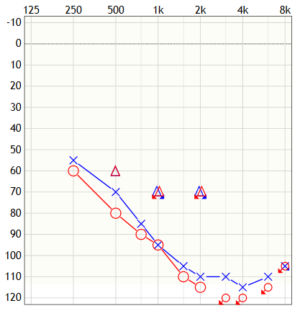
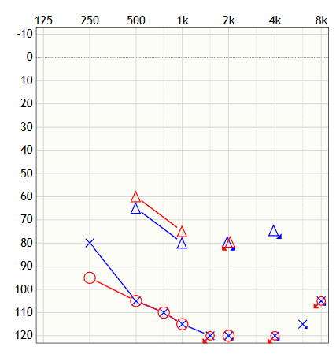
It helps to decide when a speech test is needed
Patient A
Patient B
BC vibrotactile
AB score at CI assessment: 23%
AB score at CI assessment: 0%
Notes:
15

Slide 16
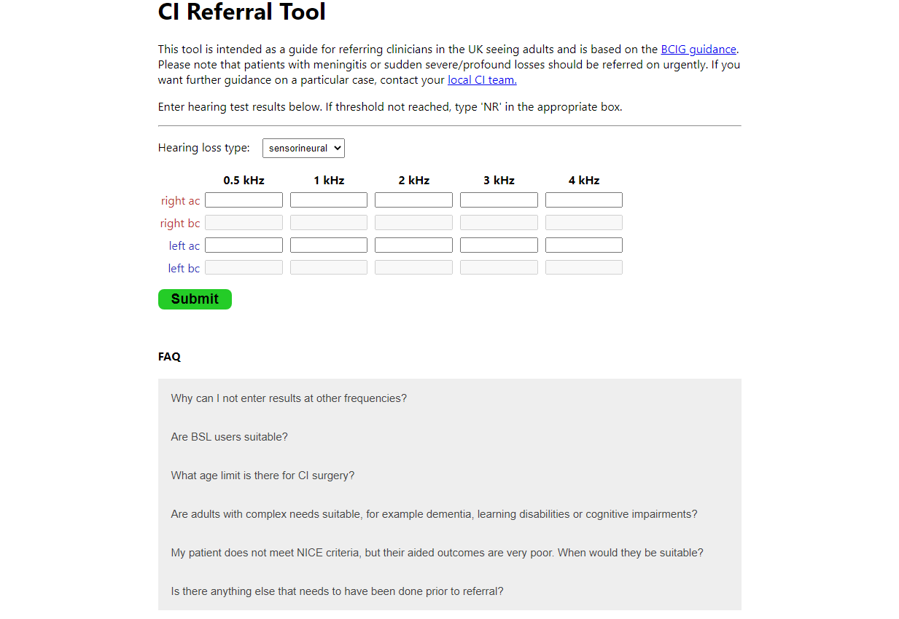
Notes:
16

Slide 17
Thank you!
The tool is available at CI Referral Tool (audioali.github.io/ci_referral_tool)
There will be a link on the BAA CI champions webpage
Tool created by Toby Crisford
User interface designed by David Honour
Ann-Marie Dickinson for advice/suggestions/trialling it and spreading the word and the rest of the department in Salford for feedback.
Whoever suggested an interactive tool in the BCIG meeting!
Code accessible at GitHub - audioali/ci_referral_tool: Web app for determining whether patient suitable for CI referral based on hearing test results
alice.honour@nca.nhs.uk
Notes:
17

