Slide 1





How to change the culture of your team – leadership, change management & influencing
Laura Turton
Head of Audiology, NHS Tayside
Notes:
Well this is a light topic to start us off!!
Starting the day with this and setting out the stall for the day – what do they want to go through and achieve from the day

Slide 2
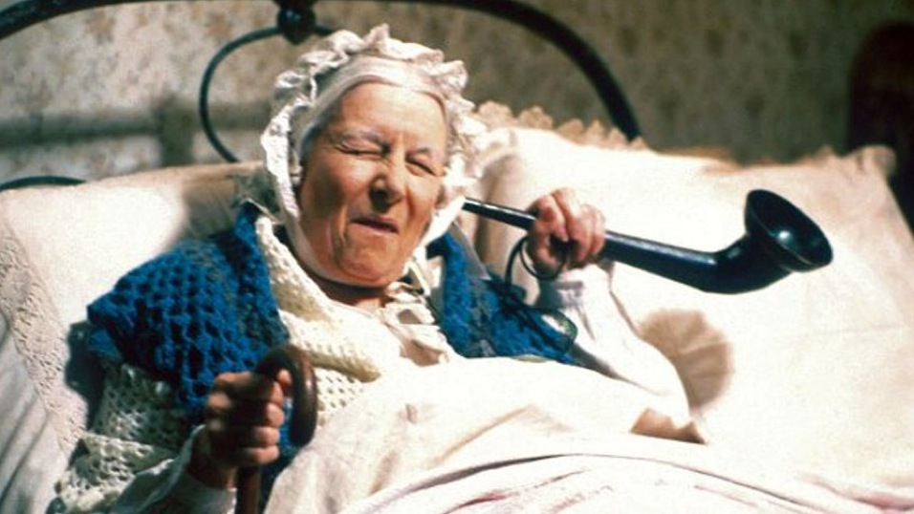
Stability is an illusion
Notes:
If it wasn’t, then this would be the current hearing aids
The best time to make changes are when you are in momentum and we are – thanks to all of the previous people who have worked on this project
From CI champs referral amazing but little change across teams. This was the first stage but we now need to move this on.

Slide 3

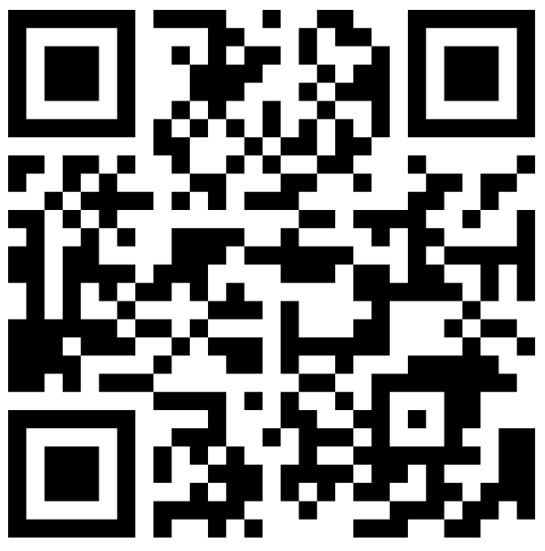
Who do we have in the room?
https://www.menti.com/al7oxfoiijdp

Slide 4
How many eligible adults in the UK are offered an assessment?
70% of those offered an assessment, want one
Bluett & Isabelle Boisvert (2017) Referral rates of postlingually deafened adult hearing aid users for a cochlear implant candidacy assessment, International Journal of Audiology, 56:12, 919-925, DOI: 10.1080/14992027.2017.1344361
Adults in UK with S&P HL
<16%
<7%
<23%?
45% of those assessed, get an implant
Richard Ramsden Centre for Hearing Implants. Annual report 2018-19. Available at https://mft.nhs.uk/app/uploads/2019/07/ANNUAL-REPORT-2018-2019-Final.pdf
<7% of eligible adults are implanted
Raine, C. (2013) Cochlear implants in the United Kingdom: Awareness and utilization, Cochlear Implants International, 14:sup1, S32-S37, DOI: 10.1179/1467010013Z.00000000077.
Raine, C., Atkinson, H., Strachan, D., Martin, J. (2016) Access to cochlear implants: Time to reflect, Cochlear Implants International, 17:sup1, 42-46, DOI: 10.1080/14670100.2016.1155808.
Some adults will…
not want one or be unsuitable
not be aware of implants, as never/infrequently/inadequately counselled about this treatment option……
Notes:
7% get an implant
7/0.45 = 15.5%
16/0.7 = 2.2.8%

Slide 5
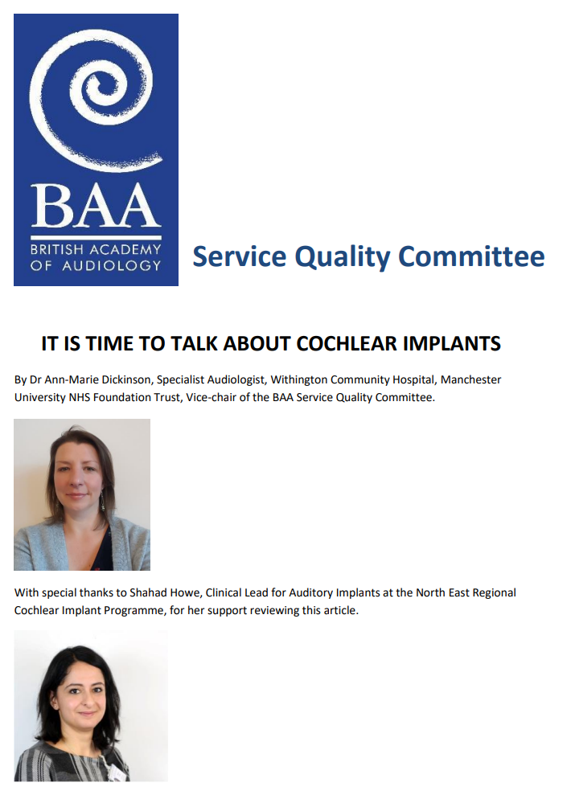



cI Champs Roadmap
Training @ BAA / BCIG, tools and support
Having confident conversations
CI Champ concept launched with BCIG
Auditing progress
02
Staff training
01
03
BAA SQC recognition that it was time to talk
Reduction in barriers from the scheme and an increase in awareness and referrals for patients
Recruitment of mentors and CI Champs
Increase in referrals for assessment, more people implanted, increased QoL (and other benefits)

Slide 6

“The past is where you learned the lesson, the future is where you apply the lesson, don’t give up in the middle.”
Notes:
Richard Branson will be our guide today as his quote inspired the timeline I want to take us through

Slide 7

Barriers to CI
Failure for a referral from primary care or audiology
Starting the conversation
Late identification of hearing loss in paediatric patients
HCP being culturally sensitive
Knowing criteria
Knowing if their hearing aids are optimally aided
Having accessible information for the patient
Acceptance of deterioration of capacity with age
Handling returning to the conversation in the future
Lack of awareness from HCP / Patient
Poor health and reluctance to undergo surgery
Lack of education for CIs for health professionals
Patients understanding a referral does not mean they will automatically get a cochlear implant
Presence of a partner who supports and restores the overall effect of their hearing loss
Knowing how the rest of the team are ok with all of the above

Slide 8

Barriers to CI
Late identification of hearing loss in paediatric patients
Knowing criteria
Lack of education for CIs for health professionals
Knowing if their hearing aids are optimally aided
Starting the conversation
Having accessible information for the patient
HCP being culturally sensitive
Acceptance of deterioration of capacity with age
Handling returning to the conversation in the future
Patients understanding a referral does not mean they
will automatically get a cochlear implant
Lack of awareness from HCP / Patient
Poor health and reluctance to undergo surgery
Knowing how the rest of the team are with all of the above
Presence of a partner who supports and
restores the overall effect of their hearing loss
Failure for a referral from primary care or audiology

Slide 9

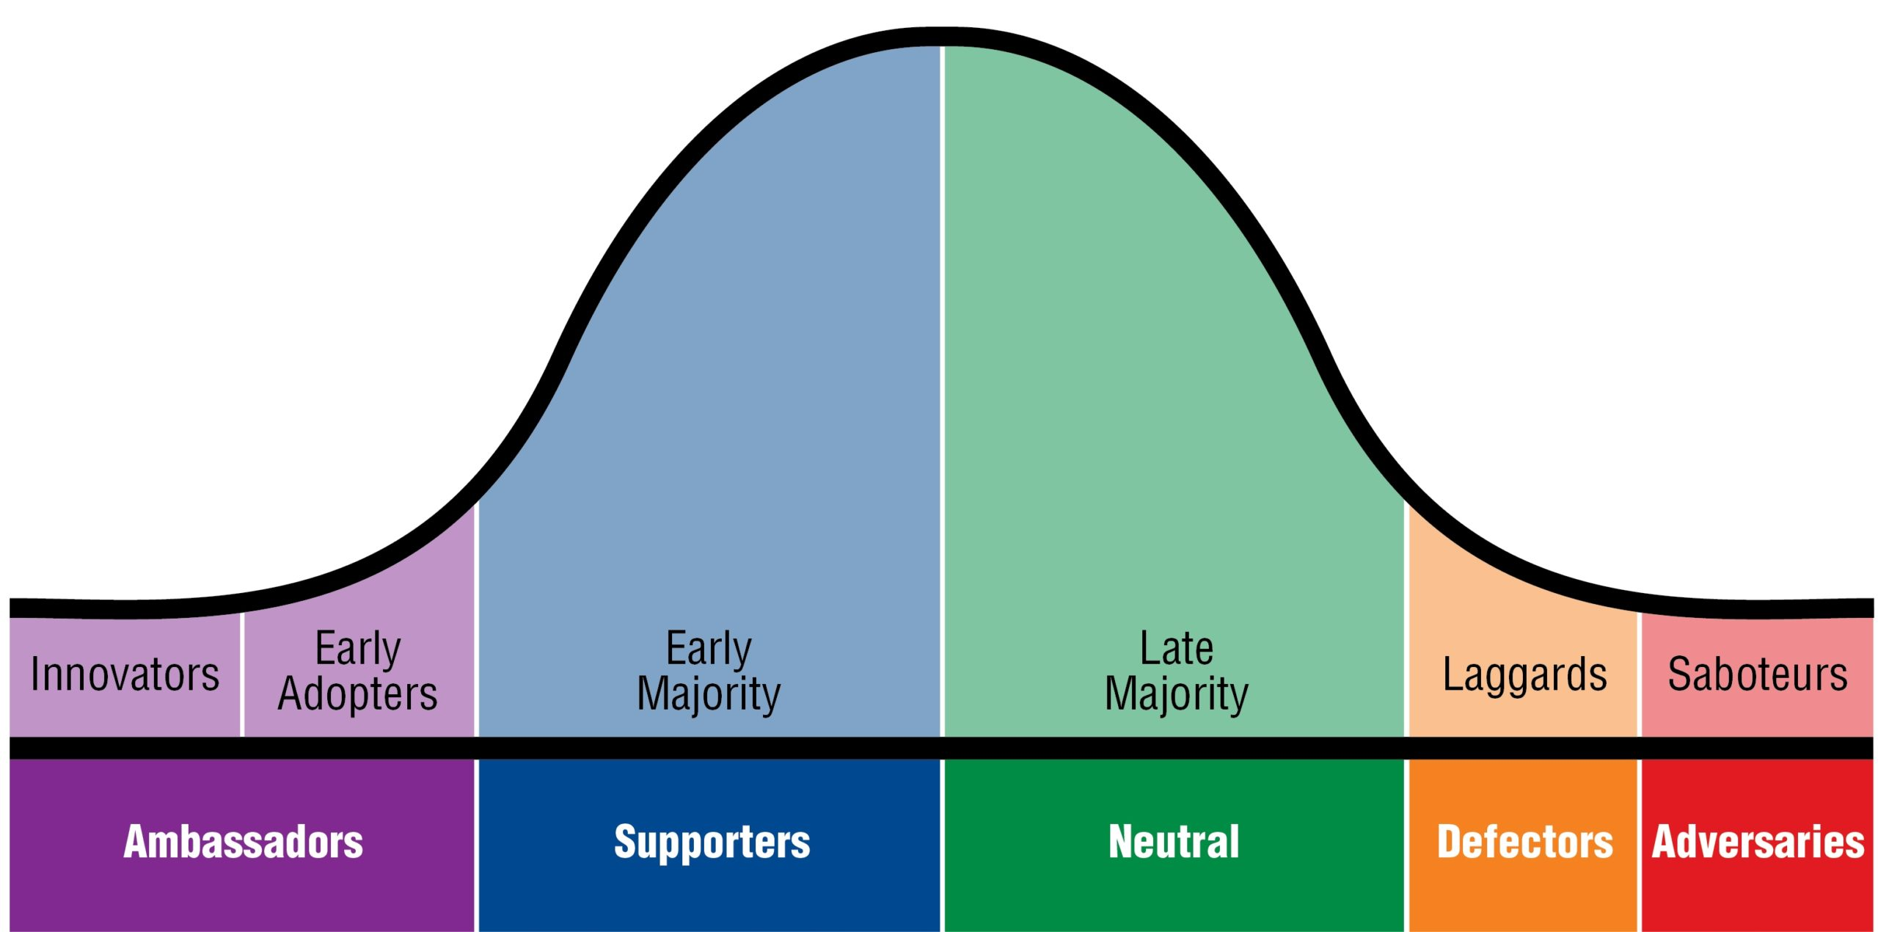


Where would you put …… on the adoption curve?

Slide 10

Change is prolonged and must be nurtured day in and day out as new habits slowly replace fixed routines
Change tends to be linear and requires a commitment to the chosen path
Changes involves us (BAA / BCIG) preparing for challenges and opportunities
Change demands special allocations of energy
Create a plan for change and communicate this

Slide 11

Influencing
Understand people’s motivations
Identify their pain points
Help to elicit goals and the criteria for success
Talk through scenarios and options
Propose the right solutions to meet their needs.

Slide 12

Influencing practically
Get your manager on side – tie in with their drivers / service development in priorities
Does your team know you are the CI Champ?
Use your audit as evidence of need and (also highlights training needs)
  Keep a spreadsheet of referred patients and referrers
  Keep a note on outcomes from referring centre
Keep it simple (referral form with auto-fills, resources to hand)
Influencing the team – training / highlighting guidance / being a go to person for their team

Slide 13


What are your barriers and how might you overcome them?

Slide 14


